Slide 1
SQL
EXCEL
POWER BI
TABLEAU
Airline Data Analysis
Dashboard
A comprehensive performance analysis leveraging SQL, Excel, Power BI, and Tableau
to uncover actionable insights from airline operations data.
Presented by Riyas M · Vaibhavi Purohit · Srija Yadav · Trupti Kunnurkar · Pruthviraj A K · N. Gowtham Sai

Slide 2
Project Overview
Business Problem
Objectives
Airlines generate vast operational data, yet turning that data into decisions requires structured analysis. This project addresses the need to evaluate carrier performance, load factors, and passenger trends across time dimensions.
01 Analyse airline performance across carriers, routes, and time periods 02 Quantify seat utilisation through load factor metrics 03 Identify growth patterns and operational inefficiencies 04 Deliver interactive dashboards for business decision-making

Slide 3
Dataset Description
The dataset captures airline operations across multiple carriers and routes, enabling granular time-based and route-based performance analysis.
Temporal
Operational
Route
Key Fields
Key Fields
Key Fields
Year · Month · Day
Carrier Name · Flights · Passengers · Seats
Origin · Destination · Distance Group
Enabling daily, monthly, quarterly, and yearly aggregations for time intelligence calculations.
Core performance indicators for load factor, utilisation, and throughput analysis.
For route, geography, and segment-based analysis across short and long-haul corridors.

Slide 4
Data Preparation
Date Field Creation
01
Derived Year, Month, and Day columns from raw timestamps for time-intelligence calculations.
Cleaning & Transformation
02
Removed nulls, standardised carrier codes, corrected data types, and resolved inconsistencies.
VLOOKUP & Joins
03
Used VLOOKUP in Excel and SQL JOINs to enrich the dataset with carrier metadata and route details.

Slide 5
Key Calculations
Core KPI — Load Factor
80%+
Transported Passengers ÷ Available Seats × 100
Values >80% indicate strong utilisation efficiency
01
02
03
04
Daily Granularity
Monthly Aggregation
Quarterly Rollup
Yearly Summary
Base-level flight & passenger counts per day
Summed totals with financial month mapping
Fiscal Q1–Q4 groupings for executive reporting
Annual benchmarks & YoY comparisons

Slide 6
SQL Work
Sample Query
Top Carriers
SELECT
CarrierName,
SUM(Passengers) AS TotalPassengers,
SUM(Seats) AS TotalSeats,
ROUND(SUM(Passengers)*100.0
/ NULLIF(SUM(Seats),0), 2)
AS LoadFactor
FROM AirlineData
WHERE Year = 2023
GROUP BY CarrierName
ORDER BY LoadFactor DESC;
Ranked carriers by total passengers and load factor using GROUP BY + ORDER BY
Route Analysis
Identified busiest origin–destination pairs using aggregated flight counts
Time Aggregations
Queries optimised with indexed columns on Year, Month, and CarrierCode for faster aggregation on large datasets.
Monthly, quarterly, and yearly rollups using DATEPART and CASE WHEN logic

Slide 7
Excel & Power BI Analysis
EXCEL
POWER BI
Formulas & Pivot Analysis
Dashboard Visuals & Insights
Key Formulas
KPI Cards
VLOOKUP, IF, SUMIF, AVERAGEIFS, and TEXT functions for data enrichment and KPI derivation
Total Passengers, Avg Load Factor, Total Flights — top-line metrics at a glance
Pivot Tables
Trend Visuals
Dynamic summaries by carrier, route, and time period with slicers for interactive filtering
Monthly trend lines, carrier comparison bar charts, and route heat maps with drill-through

Slide 8
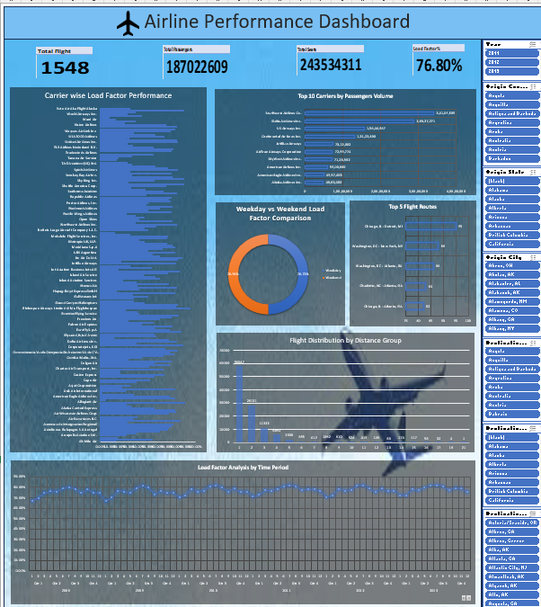
EXCEL
Airline Performance Dashboard
Interactive KPI cards · Load factor analysis · Carrier ranking · Route heat maps · Time-series trends
1,548 Total Flights
187M Total Passengers
244M Available Seats
76.80% Load Factor

Slide 9
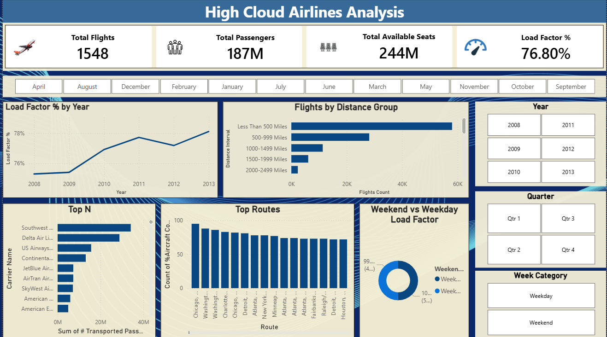
POWER BI
High Cloud Airlines Analysis
Pivot tables · Load factor by year · Flights by distance group · Top routes · Weekend vs weekday comparison
Load Factor % by Year
Flights by Distance Group
Top N Carriers
Weekend vs Weekday

Slide 10
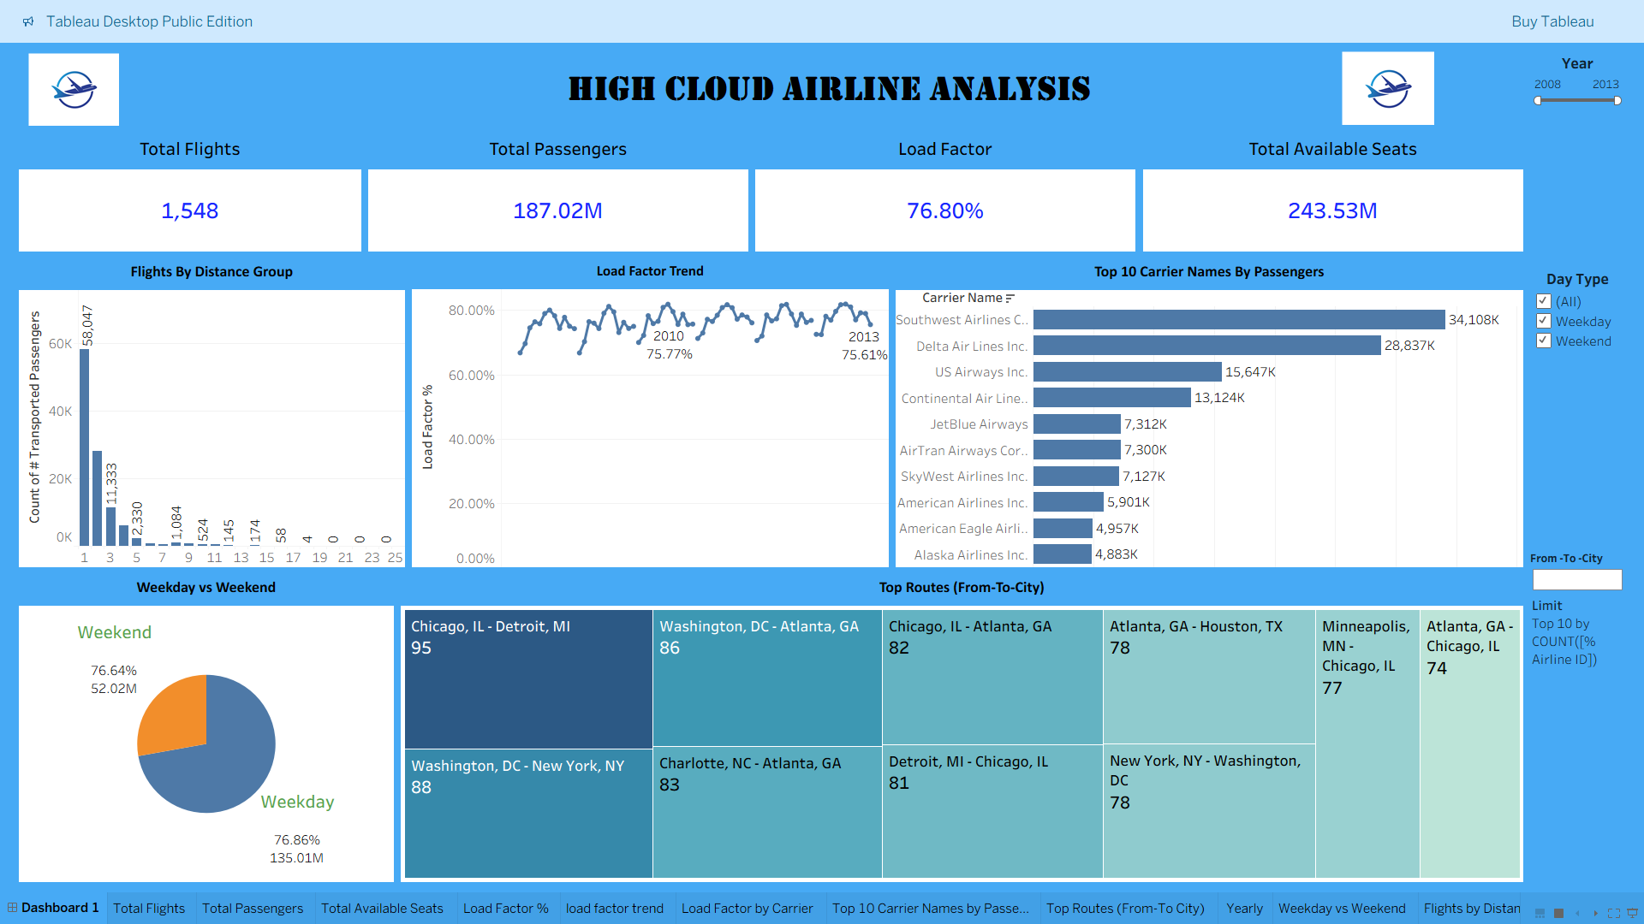
TABLEAU
High Cloud Airline Analysis
Carrier rankings · Load factor trend · Flights by distance · Top routes (city pairs) · Weekday vs weekend split
Load Factor Trend
Top 10 Carriers by Passengers
Top Routes (City Pairs)
Weekday vs Weekend

Slide 11
Tableau Dashboard
🗺
Geographic Map
📊
Carrier Comparison
Route density visualised on an interactive U.S. map with origin–destination overlays
Side-by-side bar and scatter charts comparing load factor vs. flight volume across carriers
📈
Time Series
📏
Distance Analysis
Animated trend lines showing passenger growth and seasonal peaks over multiple years
Segmented views of performance by distance group — short-haul vs. long-haul breakdowns

Slide 12
Key Insights
Four high-impact findings driving strategic recommendations
✈️
🛣️
Top 10 Carriers
Busiest Routes
Top 10 carriers account for over 85% of total passenger volume. The leading carrier consistently exceeds a 90% load factor.
Short-haul corridors dominate flight frequency. Transcontinental routes lead in passenger density.
85%+
<500mi
📅
📏
Weekend vs. Weekday
Distance Group
Weekend flights show 12–18% higher load factors on leisure routes. Business routes peak mid-week (Tue–Thu).
Long-haul routes deliver the highest load factors but lower frequency — premium demand with limited supply.
12–18%
1500+mi

Slide 13
Conclusion & Business Value
Summary of Findings
Load factor is a reliable proxy for profitability — carriers sustaining >80% outperform peers on revenue metrics
Seasonal spikes in Q2 and Q4 signal opportunities for dynamic pricing and capacity planning
Interactive dashboards in Power BI and Tableau empower stakeholders to slice data by country, state, and city in real time
Learning Outcomes
01
02
03
04
SQL Proficiency
Excel Mastery
Power BI & Tableau
Analytical Thinking
Advanced aggregations, joins, optimisation
Pivot tables, complex formulas, KPI design
Filter-driven dashboards for business
Raw data → actionable decisions

